Slide 1
Series of Lectures in ASIPP, 2011 May 17 ,June 7
and 2012 June 5
Fluctuations , Nonlinear Waves, Ｓｔａｂｉｌｉｚａｔｉｏｎ
and Zonal Flow
~ Comparison between Theory and Experiment~
^{Heiji Sanuki （佐貫平二）}
Visiting Professor for Senior International Scientists
of Chinese Academy of Science(2009)
and
Visiting Pｒｏｆｅｓｓｏｒ ｏｆ ＡＳＩＰＰ and SWIP
^{This lecture has been} partially presented in ASIPP(2009May)

Slide 2
Menu of Series of Lectures
Part I(-1 and –2)
1. Having a Glimpse of Topics during 1960’s and 1970’s
( from the viewpoint of a Master and Doctor student (H.S))
~ Discover new things by studying the past through
scrutiny of the old~（ 温故知新）
2. Overview of Local and Nonlocal Analysis of Plasma Waves
Comparison between Experimental Observations and Theory Predictions
Part II(-1 and -2)
3. Stabilization (Control) of Instabilities and/or Fluctuations in Plasmas ( due to Velocity Shear effect and PM Force)
4. Mathematical Method(Tool) and its Application to Nonlinear Phenomena( Brief View of Nonlinear Wave Theories)
5. Some Topics associated with Zonal Flow and GAM

Slide 3
Part II
3. Stabilization (Control) of Instabilities and/or Fluctuations in Plasmas ( due to Velocity Shear effect and PM Force)
4. Mathematical Method(Tool) and its Application to Nonlinear Phenomena( Brief View of Nonlinear Wave Theories)
5. Some Topics associated with Zonal Flow and GAM
Detailed Topics（2011 year)
Stabilization due to Plasma rotation or electric field shear,
Stabilization by P.M. Force, Confinement Improvement
by Plasma Rotation, Generation Mechanism of E, Plasma
Rotation Exp., E-field stabilization mech., Timofeev mode,
Strong shock theory

Slide 4
Today’s Topics
Part II-2
4. Non-secular Perturbation Theory(Reductive
Perturbation Method) and its Application to
Nonlinear Waves and Convective Cells
5. Some Topics associated with Zonal Flow and
GAM(revisited and on-going topics)
Detailed Topics
Reductive Perturbation Method, Burgers Equation, Gravitational Waves, Convective Cells, Zonal flow ,GAM etc.

Slide 5
Reductive Perturbation method(逓減摂動論）
# Multi-time and space expansion technique
References
Non-secular perturbation method based on multi-time expansion
1) N.N. Bogoliubov and Mitropolsky, ”Asymptotic Methods in the Nonlinear Oscillation”( translated from Russian) Hindustan Pub. Co(1961)
Reductive perturbation method based on multi-time and space
expansion (powerful tools for stable and/or weakly unstable system)
1) A. Jeffery and T.Taniuti, “ Nonlinear wave propagation”(1964)
2) N.Asano, Suppl. of Progr. of Theor. Phys.(1974), inhomogeneous sys.
Topics of Today
(A) Propagation of nonlinear gravitational wave
(B) Electromagnetic drift wave turbulence and convective cell formation( similar to zonal flow)

Slide 6
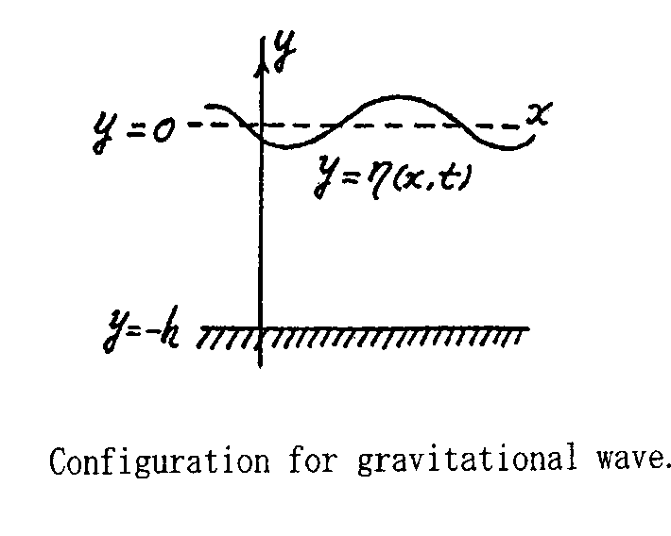
(A) Propagation of nonlinear gravitational wave(1)
(imcompressive),
(Vortex free),then
(Laplace eq.)
at y=-h
at y=
at y=
Streched coordinates

Slide 7
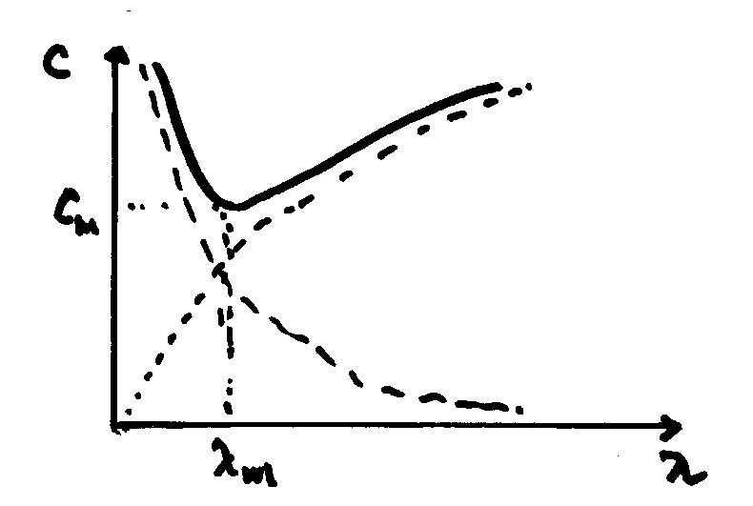
Propagation of nonlinear gravitational wave(2)
From
Dispersion relation
From
Moving velocity
is determined as the group velocity
From
Equation for slow variation with
Dispersion relation for gravitational wave
surface tension effect
From
----->
Convective cell mode

Slide 8
Propagation of nonlinear gravitational wave(3)
From
Nonlinear Schrödinger eq.
Whether the solution is stable or not against amplitude modulation
depends on the product of coefficients p and q.
Nonlinear gravitational wave is modulationally stable for pq<0
but is modulationally unstable for pq>0.

Slide 9
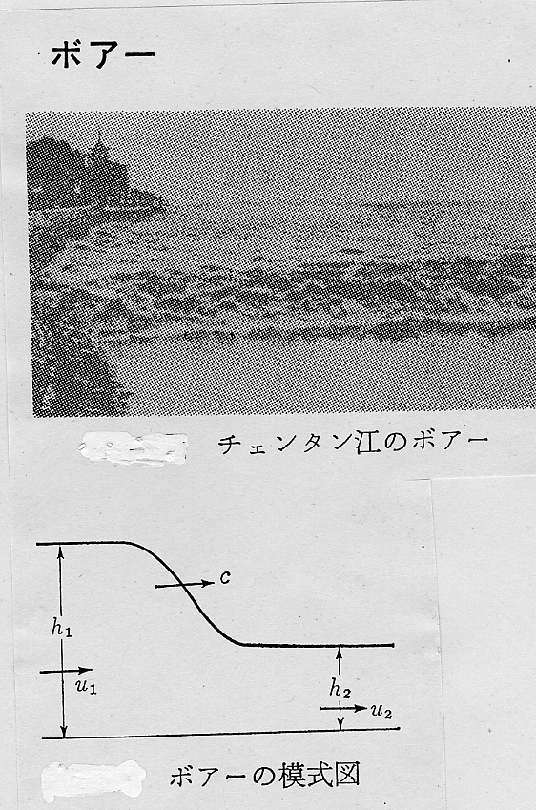
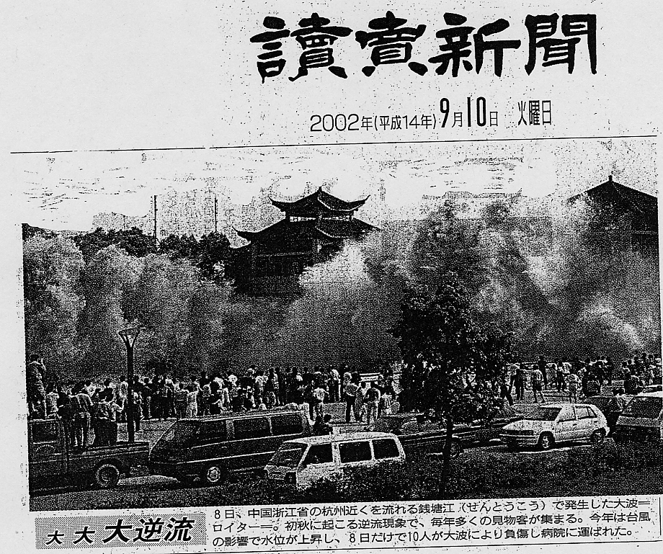
A Novel Nonlinear Wave Phenomena in Nature (Tea Break)
Tidal Bore in 銭塘江
downstream
upper-stream
downs-tream
Shock-like wave
upper-stream
２００2年９月には海水の逆流現象見学中の３０人が高波にさらわれた（６人重傷）

Slide 10
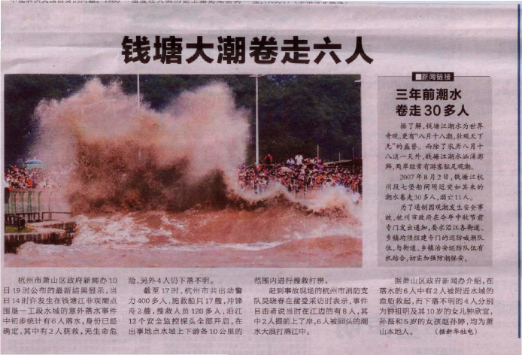
合肥晩報、２０１０年１０月１１日

Slide 11
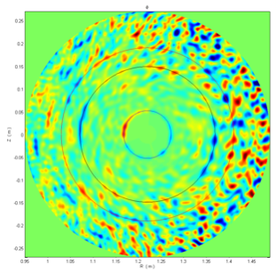
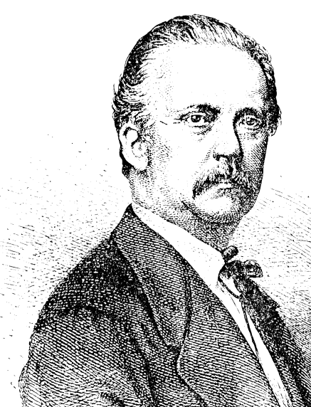
Discovery of new truths by studying the past through scrutiny of the old(温故知新)
Vertex(Convective cell,zonal) Motions in Nature
Typhoon, Giant Red Spot in
Jupiter (Zonal flow)、
El Nino, La Nina、etc
Review of vortics
International J. of Fusion Energy
(1977-1985, particularly, 77~78, F1R26)
# Hermann Helmholtz(1858)(general)
# Winston H. Bostick (Vortex Ring)
# D.R.Wells and P.Ziajka (Theory and Experiment) , others
Zonal Flow
What kind of dynamics determines Structure of Vortices(2D) ？
（unsophisticated question）

Slide 12
(B) Electromagnetic Drift Wave turbulence and Convective Cell Formation(1) by Sanuki and Weiland
#Convective cell formations( electrostatic ) have attracted much
interest from turbulence and related anomalous transport
in 1970s and 1980s
#Electrostatic convective cell formation based on nonlinear drift
wave model (Hasegawa-Mima eq.)(1978)
# Electromagnetic convective cell formation based on nonlinear
drift Alfven wave model ( Sanuki-Weiland model(1980))
Viscosity term

Slide 13
Electromagnetic Drift Wave turbulence and Convective Cell Formation(2)
Electromagnetic convective cell formation and its spatial structure
Reductive perturbation method
Boundary Value Problem （x） and Nonlinear Analysis (y)
Periodic boundary condition in x-direction

Slide 14
Electromagnetic Drift Wave turbulence and Convective Cell Formation(3)
From First order, we get dispersion relation for linear drift Alfven mode
(m :radial mode number)
From second order:
From third order:
Convective cell
mode
Nonlinear Schrödinger
Eq. with viscos damping

Slide 15
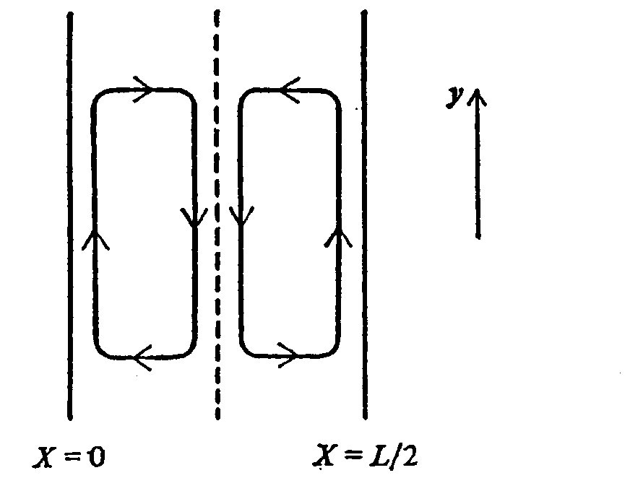
Electromagnetic Drift Wave Turbulence and Convective Cell Formation(4)
Coefficients of NS Equation
Following the theory by H. Sanuki et al.(1972)
Modulational insta. condition
Elongated structure of Convective cell
J.Weiland, H.Sanuki and C.S.Liu, PoF(1980)

Slide 16

“Old Wine in New Bottles”

Slide 17
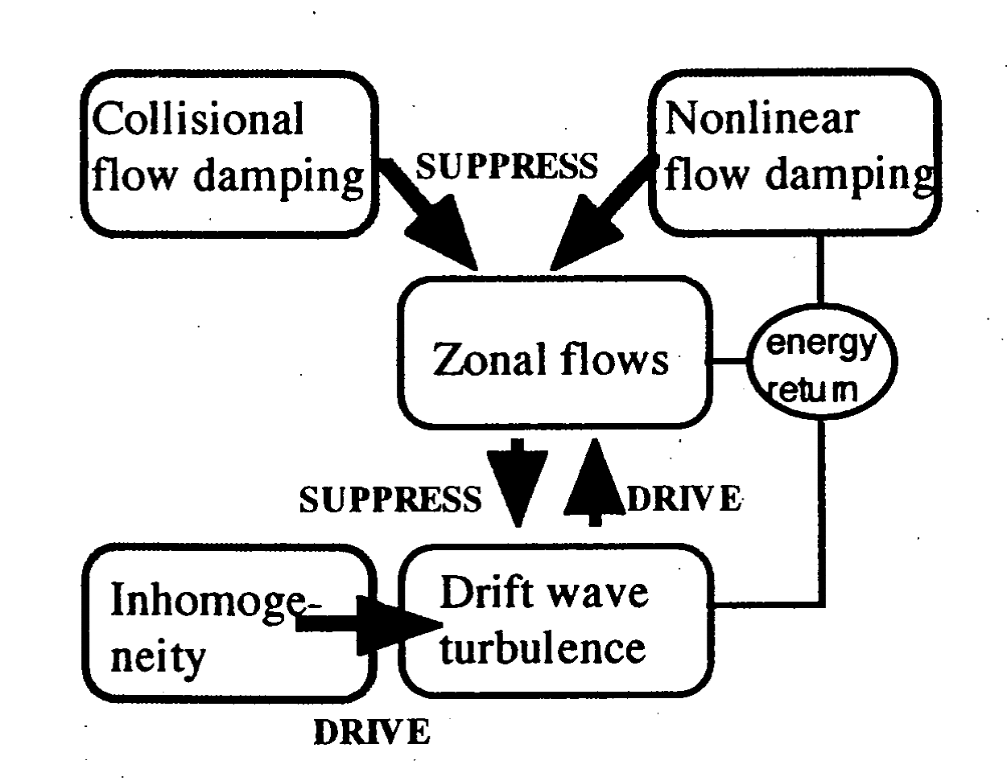
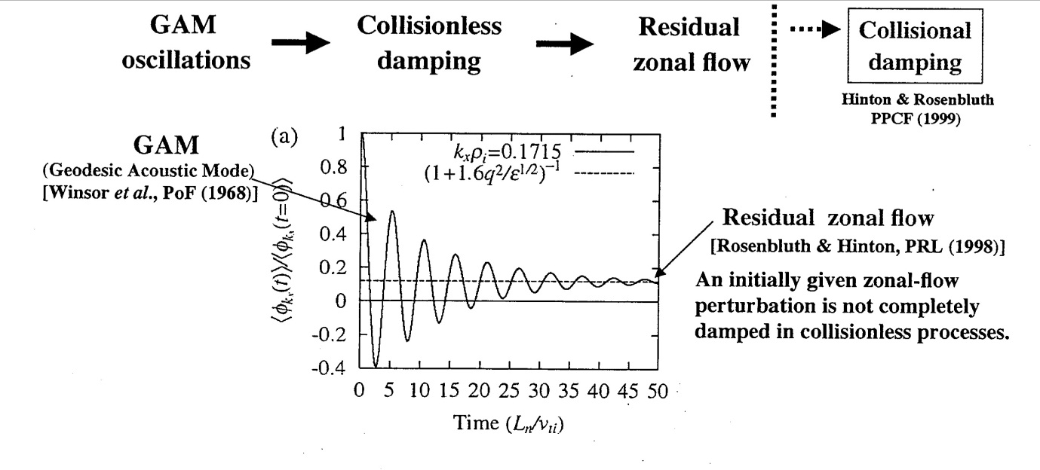
Schematic Illustration of Self –Regulation and Dynamics for Zonal Flow in Toroidal Systems
From NIFS report－８０５(2004) by K Itoh et al.
From Jpn. Phys. Soc.
Meeting(2007,Nov.)
by H.Sugama et al.
R-H Formula

Slide 18
Overview of Recent Progress in Studies of Zonal Flow
Improvements on both of theoretical modeling and diagnostics for
measurement data with high temporal and spatial resolutions
Theories
#Z. Lin et al.(1999), A.M.Dimits et al.(2000) and others:
Turbulence is quenched for weakly unstable cases but stationany states with finite amplitude of zonal flow and turbulent fluctuations are realized in highly unstable cases
# K.Hallatschek(2000):
Condensation of micro-modes into global modes by direct
nonlinear simulations (DNS)
# A.Smolyakov and P.H.Diamond(2000):
Zonal flow evolve into a kink- soliton-like structure with coherent structure in drift wave-zonal flow turbulence

Slide 19
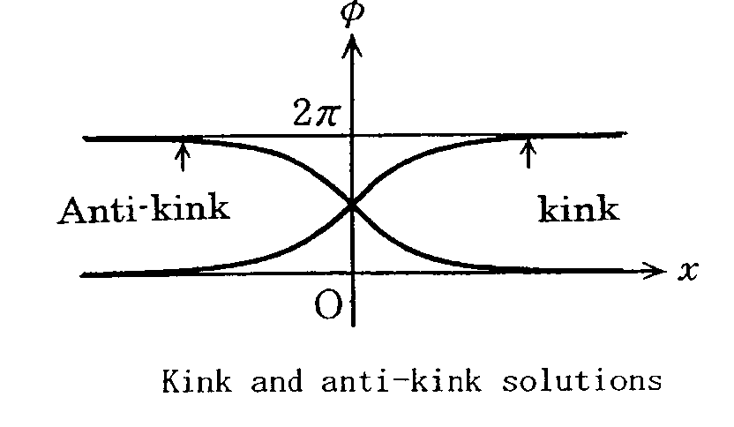
A.Smolyakov and P.H.Diamond(2000) (continued)
Boundary condition
Stationary solution is described by the following Kink-type solution
Note: If this eq. may tend to Burgers type equation under some boundary condition,
we get “shock like solution”

Slide 20
Comment on Analytical Tools to solve Burgers Equ. ~Hopf-Cole Transformation~
# Burgers Equation
nonlinear
viscosity
“Nonlinear eq. may be reduced to linear eq. by nonlinear transformation”
-------->
Heat equation
How to solve nonlinear diff. eq. depends on how to find
nonlinear transformation

Slide 21
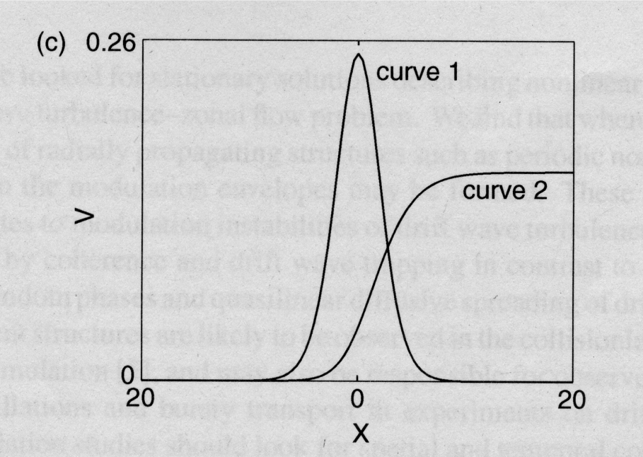
Recent Progress in Studies of Zonal Flow (continued)
#P.Kaw, R.Singh and P.H.Diamond(2002):
Coherent nonlinear structure of drift wave turbulence
modulated by Z.F
-→ Drift wave turbulence can sustain coherent, radially propagating envelop structures such as “soliton”, “shock”,“ wave trains”,etc.
Sagdeev Potential Formalism

Slide 22
Recent Progress in Studies of Zonal Flow (continued)
K.Itoh, K.Hallatschek, S.Toda, H.Sanuki and S.-I. Itoh:
J.Phys. Soc. Jpn.73 (2004)2921., “ Coherent Structure of Zonal Flow and Nonlinear Saturation”
Evolution of zonal flow and ambient turbulence are given as
[Smolyakov & Diamond(2000), P. Kaw et al.(2002)]
Reynolds Stress term
:Zonal flow velocity
: Slow modulation
of drift wave
: damping rate of ZF

Slide 23
Studies of Zonal Flow [K.Itoh et al.(2004)] ~continued(2)
#Linear response:
: zonal flow
: resonance
broadening
Note:
P.H.Diamond et al, NF(2001)
Diffusion type
# Higher order response from zonal flow ,

Slide 24
Studies of Zonal Flow [K.Itoh et al.(2004)] ~continued(3)
Autocorrelation times for drift waves are much shorter
than that of zonal flow
Resonance broadening is dominant and symmetry with respect to
Note: P Kaw et al.(2002)
In collisionless limit,
should be replaced by
factor in R-H formula
→Reynolds Stress term
[see, K. Itoh et al., IOP Pub.,
Bristol,1999]

Slide 25
Studies of Zonal Flow [K.Itoh et al.(2004)] ~continued(4)
Normalized variables
nonlinear
dissipation
For periodic boundary condition,
: integration constant with

Slide 26
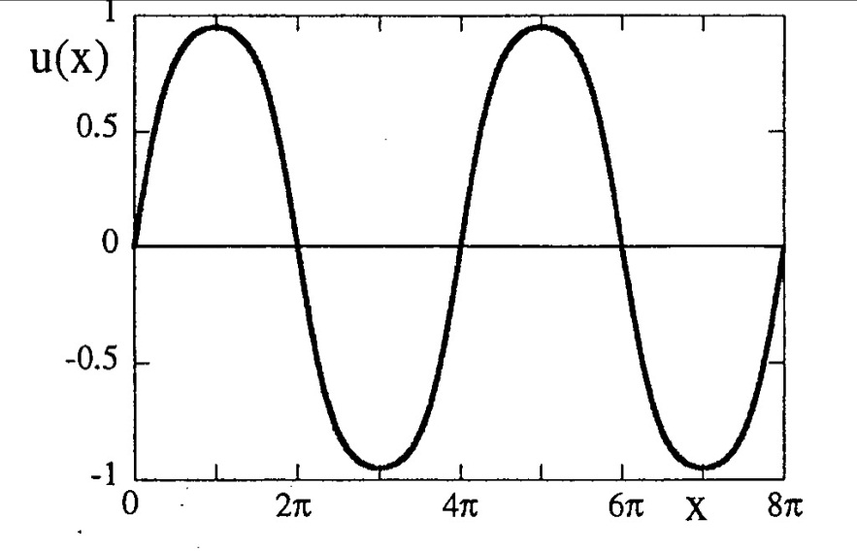
Studies of Zonal Flow [K.Itoh et al.(2004)] ~continued(5)
Characteristics of the solution
# Short wavelength component with
are stabilized by the higher order derivative term
# Flow is generated in long wave-length region of
# Zonal flow energy is saturated by nonlinearity and
by higher-order dissipation
Magnitude of drift wave fluctuation
in presence of zonal flow
For integration const.
Kink-like soliton solution
(see,Kaw et al.(2002))
Stationary state of normalized
solution u(x)
ZFs evolve into a stable stationary
structure

Slide 27
Experimental observations of GAM(1)
From Fujisawa et al( IAEA paper in Chengdu)

Slide 28
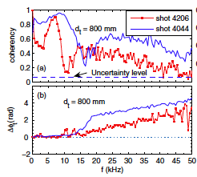
Experimental Evidence of GAM(2)
HL-2A tokamak (SWIP) proved, for the first time, the existence of GAM by showing the complete symmetry (m=n=0) and coupling with turbulence.
IAEA EX/P4-35 by L.W. Yan et al.
K. J. Zhao et al.
PRL 96 255004 (2006)
This marvelous result was discussed initially under close collaboration with NIFS

Slide 29
Identification of ZF in a Toroidal Plasma in CHS
A. Fujisawa et al. PRL 93(2004)165002
Zonal flow with and
without a transport barrier
(a)Density fluctuation amplitude
(b)Zonal flow amplitude before
and after transition
Transition time
#Potential profile before and
after transition

Slide 30
Experimental Evidences of GAM(３)
Elongation dependence and
scaling of frequency versus
Other parameter dependence

Slide 31
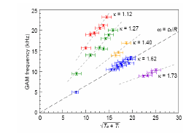
Elongation and safety factor dependence on GAM (Experiment)
GAM frequency
(Conway,FEC2006 EX/2-1)
Motivations:
Clear formula for frequency of GAM including shaped
parameters has not been obtained

Slide 32
On going topics of Geodesic Acoustic Modes(GAM) (1)
Effect of Plasma Shape on coherent modes such as GAM are important,
as well as those on microinstabilities and mean flow
Zhe Gao, Ping Wang and H. Sanuki: ” Elongation and finite aspect
ratio effects on GAM” (presented in 13th International Workshop
on Sperical Torus 2007, Oct.10-13, Fukuoka, Japan), PoP(2008), NF(2009)
GAM dispersion in large aspect ratio and circular cross section
limit
References: Sugama et al.(2006),
Gao, Itoh, Sanuki and Dong, PoP 15(2008)

Slide 33
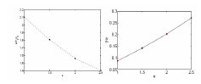
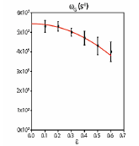
Elongation and Aspect ratio effects on GAM (Simulation)(2)
Frequency
Frequency
Growth rate
Elongation effects
Result by Villard et al.(2006)
Aspect ratio effects
Results by X.Q.Xu et al.,
NF47(2007),
TEMPEST Simulation by
Xu et al. PRL(2008)

Slide 34
On going topics of Geodesic Acoustic Modes (3) by Gao et al.(2007)(2008)
Effects of Elongation and Aspect Ratio on GAM Dispersion
Zhe Gao, Ping Wang and H. Sanuki, Phys. of Plasmas 15(2008)74502.
#1 When elongation increases, real frequency dramatically decreases.
#2 Frequency decreases as inverse aspect ratio increases.
------→ Damping rate may become very small
Theoretical results are in good agreements with both simulation
results and experimental observations, although more clear
formula such as parameter dependence is required

Slide 35
On going topics for GAM Studies(Continued)
#Experimental identification and characteristics of ZFs,
GAMs in a variety of toroidal fusion devices
(Fujisawa et al. Nucl. Fusion 47,S715(2007))
#Comparison between experimental observations and
theoretical predictions are made in HL-2A tokamak
(Y.Liu et al. Nucl. Fusion 45,S239(2005))
#Physical mechanism leading to turbulent transport,
ZF generation, its role in transport reduction in HL-2A
GAM dominates ZFs in high –q region and ZF dominates
in low –q region( see, damping rates in both regions)

Slide 36
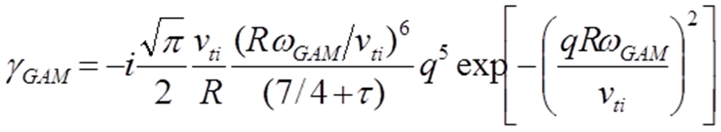
On going topics for GAM Studies(Continued)
Z.Gao, K. Itoh, H.Sanuki and J.Q.Dong ,Phys. Plasmas
15(2008)
#Feng Liu, Z.Lin, J.Q.Dong and K.J.Zhao, Phys.
Plasmas 15(2010)
Linear and Nonlinear simulations confirmed
theoretical prediction
#X.Q.Xu et al, PRL100(2008)215001
TEMPEST Simulation, confirm the ε-dependence on collisionless
damping rate of GAM
#T.H.Watanabe, H.Sugama and M.Nunami,
to be published in NF(2011)
Effect of electric field on Zonal Flow and Turbulence in Helical
Configuration

Slide 37
On going Topics for Zonal Flow Gam and related Phenomena (Theory and Experiments) (cont.)
Lots of on-going topics are discussed in APTWG 2012
Meeting(Chengdu)
Examples:
*P.H.Diamond(PL-OV) overview of theory issues
*M.Kikuchi(PL-1) overview of questions and issues
*G.R.Tynan(PL-2) experimental evidence of Zonal flow
*G.S.Xu(PL-3) zonal flow limit-cycle oscillation etc.
*N.Tamura nonlocal Transport Phenomena(HL-2A,LHD)
*K.Itoh(B-01) report international research start-up on
*Z.H.Lin(D-04) “joint study of data analysis”
*Lots of experimental evidence in HL-2A, EAST, KSTAR,
DIII-D, LHD,CHS, other devices
*Lots of theory modeling and predictions are reported

Slide 38
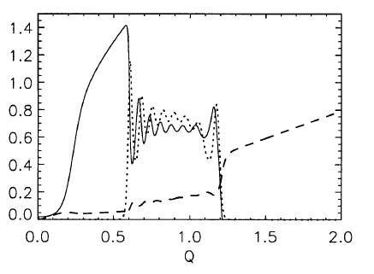
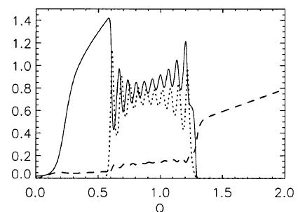
Predator-Prey Model
Note:Extended Predator-Prey Model by
K.Miki and P.H.Diamond, NF51,(2011) including GAM

Slide 39
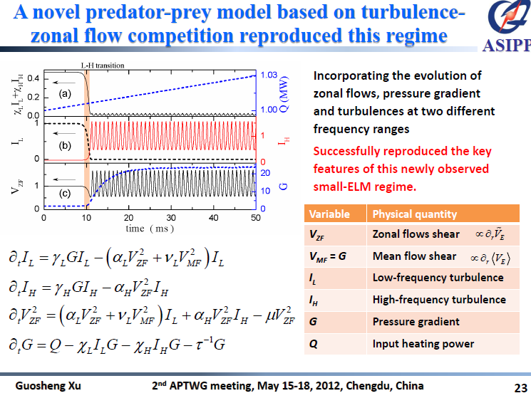

Slide 40
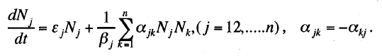
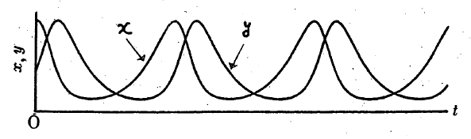
Observations and Predator-Prey Model(cont.)
Experimental Observstions:
1)DIII-D: transition from GAM to ZF may help trigger L-H tran.
2)ASDEX-Upgrade: strong relation between GAM and
turbulence is observed at high-q and low density but no sign
of transition from GAM to ZF
3)HL-2A: Mixture of nearly-zero frequency ZF and finite
frequency GAM is observed(Coexistence)
←---→single significant spectrum in DIII-D,ASDEX-Upgrade
Note: Gneralized Lotka-Voltrra equation
Case of Two variables
examples
*Fish-Plankton
*Rabbit-Fox

Slide 41
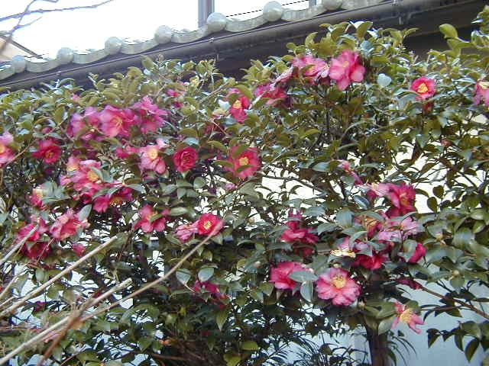
謝謝清聴
落紅不是無情物
化作春泥更護花
（龚自珍 己亥雑詩）
再見
Notes:
41

Slide 42
ACKNOWLEDGMENTS
I would like to acknowledge many collaborators and friends for their continuous and fruitful discussions. This visit is supported
by Prof. Li Jiangang and the Chinese Academy of Sciences、 Visiting Professor for Senior International Scientists(2009 fiscal year) ,and
also supported by Prof. Liu Yong (SWIP). The present topic is partially discussed under close collaborations with Jan Weiland, C.S. Liu , M. Kono, K.C. Shaing, R.D. Hazeltine, NIFS CHS group, and staffs ( K. Itoh, A. Fujisawa, K. Ida, S. Toda, et. al ),Tsinghua University (Gao Zhe et al.) and SWIP ( Dong Jiaqi ,Wang Aike et al.)
Finally I would like to acknowledge all friends and staffs,
students who take care of lots of arrangements of my visiting ASIPP since my first visit, 1991.
Notes:
42

